Slide 1


Long Term Plan 2024 - 2029
Presentation - Country / segment
#Meeting date#

Slide 2
Synthetic table of analysis required
We ask you to simplify and limit the size of your presentation as much as possible and focus on key points
Type of analysis | Indicators | Minimum requirements | Template
Assumptions ZGP and organic growth | Major assumptions of the plan Renewals / win / losses Investments: detail of capex (whatever the financing mode) Revenue per contract ZGP & growth Margin expectations and ROCE on new contracts | Revenue per contract >10M€ | ZGP – Pages 14 to 16 Growth Plan - pages 18 to 20
Comparison with 2022 sensitivity LTP | Revenue EBIT Investments (all financing modes) FCF | Last year plan’s financial metrics, on EBIT and Free Cash Flow for the 3 first years of the plan | Pages 8 & 9
Year on year analysis (changes from one year to another) | Revenue EBIT | Renewals, contracts won & lost, indexation, operations & performance, non recurring should be visible Contract management actions sustaining profitability increase | Total – Page 12 ZGP – page 15
Consistency of key indicators throughout the plan | EBIT Margin (% ROA) Amortization level (% ROA) Net Profit Margin (% ROA) Implicit Interest rate Free Cash Flow (FCF) level & FCF > 0 ROCE post tax | Any major impact should be explained | See sheet « Plan output » in the excel file

Slide 3

1. Strategic Review

Slide 4
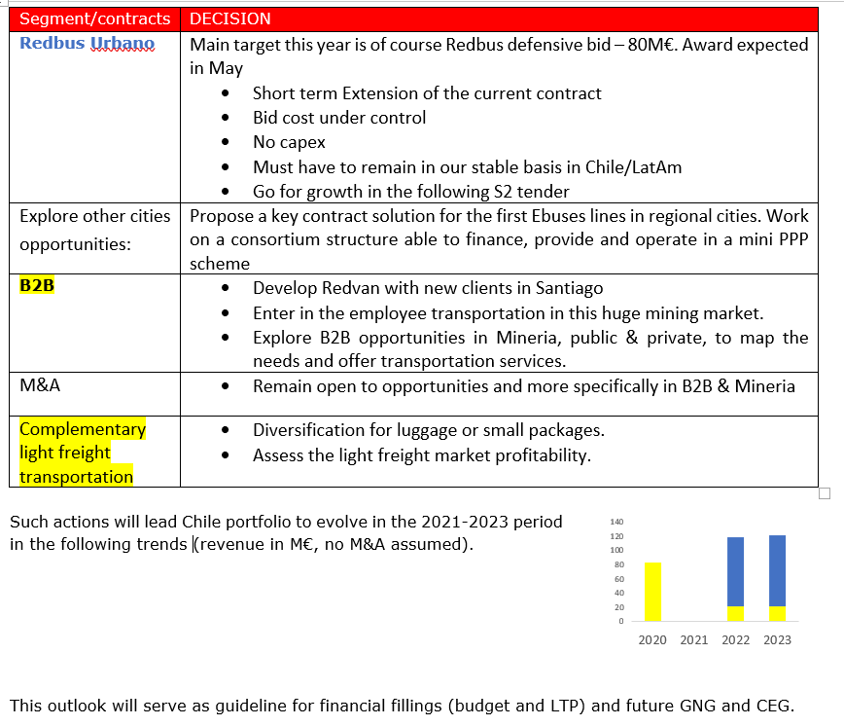
Implementation in the LTP of the decision statement
Decision statement should be strictly applied. A specific slide will have to compare decision statement with effective hypothesis taken in LTP
Any deviance should be previously validated with Strategy Department
Contract management actions would have to be highlighted in your presentation
For segments of activities defined as red or orange, countries will present the underlying action plan for recovery (timeline, specific milestones) and a year on year bridge sustaining profitability turnaround
For segments of activities defined as yellow, countries will present their growth assumptions and explain the level of development costs, the capital intensity and level of margin retained
Any significant contract considered at risk (ZGP and Growth) will be isolated on a dedicated segment to update LTP if necessary

Slide 5
Strategic review – main comments
Comment 1
Xxxxxxxxxxxxxxx
Comment 2
Xxxxxxxxxxxxxxx
Comment 3
Xxxxxxxxxxxxxxx
Comment 4
Xxxxxxxxxxxxxxx

Slide 6

2. Executive Summary

Slide 7
Executive Summary
Comment 1
Xxxxxxxxxxxxxxx
Comment 2
Xxxxxxxxxxxxxxx
Comment 3
Xxxxxxxxxxxxxxx
Comment 4
Xxxxxxxxxxxxxxx

Slide 8
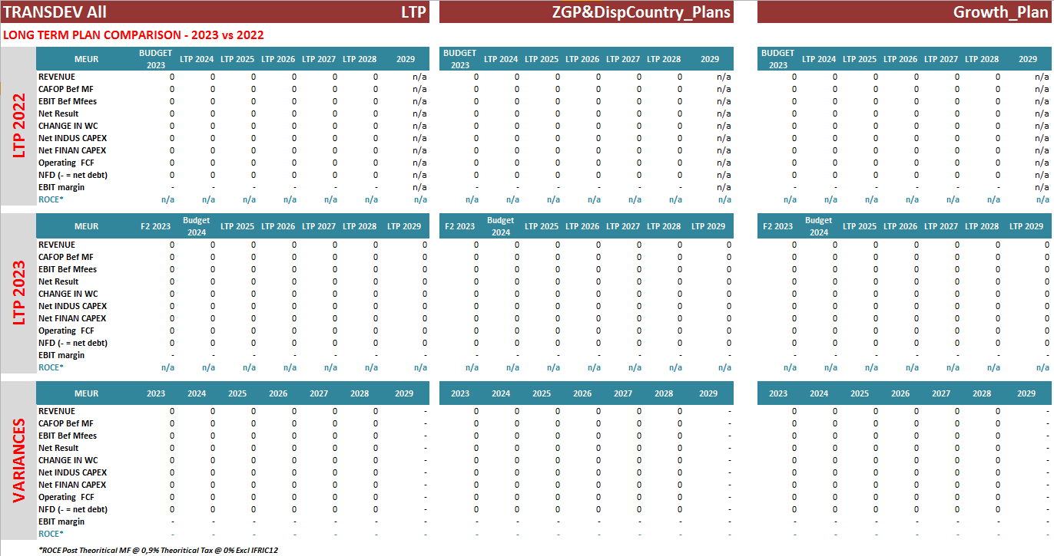
Executive Summary – Main changes
Sheet 8a: Double click on the context and select an activity if you want to focus on a particular element

Slide 9
Executive Summary – Comments on main changes
Comments on main changes
Comment 1
Comment 2
Comment 3
Comment 1

Slide 10
Key Indicators – Total LTP 2023 (2025-2029)
Comment 1
Comment 2

Slide 11
Key Indicators – Total LTP 2023 (2025-2029)
Comment 1
Comment 2

Slide 12
Revenue bridge – Total LTP 2023
Comments on main changes
Comment 1
Comment 2
Comment 3
Comment 1

Slide 13

3. Zero Growth Plan

Slide 14
Zero Growth Plan - Commercial Defensive - Revenue
Growth of the existing portfolio for each segment consistently with the expected market growth
Renewal rate assumption by segment
Assumptions about margin before and after renewal
Probability rate of renewal by contract

Slide 15
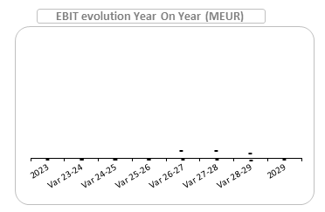
Zero Growth Plan - Performance – EBIT trends
Margin evolutions (EBIT)
Margin improvement by segment
Implemented action plans : specify on which contracts if significant
Impacts on margins
Comments on transverse actions
Purchase : fleet, fuel and sub-contracting
Operations
SG&A evolution
IT systems deployment
Assets disposals
….

Slide 16
Zero Growth Plan - CAPEX Requirements
Financing policy of rolling stock
Investments in CAPEX (all financing mode)
Obligations in terms of fleet renewals
Detail of fleet renewal commitment
Number of vehicle to renew
Global comment on average age of the fleet by activity segment
Detail and comments about assumptions: unit price of vehicle, monthly lease payment
Comments on other CAPEX
Building
IT, …
Assets disposals

Slide 17
4. Growth Plan

Slide 18
Organic Growth - Assumptions
Assumptions activity 1
Detail 1
Detail 2
Detail 3
Assumptions activity 2
Detail 1
Detail 2
Detail 3
Assumptions activity 3
Detail 1
Detail 2
Detail 3

Slide 19
Key Indicators – Organic Growth Plan 2023 (2025-2029)
Comment 1
Comment 2

Slide 20
Organic growth - CAPEX Requirements
Financing policy of rolling stock
Investments in CAPEX (all financing mode)
Obligations in terms of fleet
Detail of fleet commitment
Number of vehicle
Global comment on average age of the fleet by activity segment
Detail and comments about assumptions: unit price of vehicle, monthly lease payment
Comments on other CAPEX
Building
IT, …
Assets disposals

